Slide 1
NC World History Final Review
Unit Summaries

Slide 2
Methods of Social Studies
- Primary Sources
-Firsthand account written by the person who experienced the event
examples: diary, journal, autobiography
- Secondary Sources
- Account that was written by someone that did not witness the event
examples: textbook, biography

Slide 3
Prehistoric Civilizations
Paleolithic Age
“ Old Stone Age ”
Paleolithic People were primarily nomads
Neolithic Age
“ New Stone Age ”
Began to develop technology to meet basic needs
Neolithic Revolution
- change from nomadic life to the development of permanent
settlements
(Development of agriculture and the Domestication of animals)

Slide 4
1. Mesopotamia
- “ Land between two Rivers ”
Area located in the Middle East
Fertile Crescent region- area of fertile land between the Tigris and Euphrates Rivers
First Civilization – Sumerians
System of writing - Cuneiform ( wedge-shaped writing)
Hammurabi’s Code (1st written law code)

Slide 5
2. Egypt
located in North Africa
settled along the Nile River
Polytheistic religion
Egyptian ruler was known as a Pharaoh
System of writing known as Hieroglyphics
Built pyramids that served as tombs for the pharaohs and later for wealthy individuals

Slide 6
3. Indus River Valley
located in India along the Indus River Valley
Two main cities- Harappa and Mohenjo-Daro
Monsoons- seasonal winds that brought rain in spring and summer, brought dry air in Fall and Winter

Slide 7
4. China
located along the Huang He or Yellow River
Developed dynasties to rule China ( Tang and Song Dynasties)
Mandate of Heaven - need the approval of god to rule over the people
Development of the Silk Road - (Trade Route)
opened up trade with the west. As a result, new Chinese goods moved West and Western goods flowed into China
( Resulted in Cultural Diffusion)

Slide 8
Classical Civilizations
The two classical civilizations are;
(1) Greece
(2) Rome
- Each had a strong, well-organized government and a prosperous economy
- These civilizations took over vast amounts of land and other cultures.

Slide 9
GREECE
- collection of independent city states due to mountainous region
Two most famous city-states; Athens and Sparta
Athens- Valued education and democracy
Sparta- Valued militarism
Important Individuals
- Alexander the Great- Hellenistic culture
- Socrates, Aristotle, Plato – Greek philosophers

Slide 10
ROME
developed the Republic form of government
most powerful governing body was the Senate
Patricians- landowning upper class
Plebeians - working middle class
Pax Romana - 200 years of Roman Peace, Golden Age of Rome
Twelve Tables of Roman Law - greatest contribution of the Romans
- decline of the Roman Empire resulted in → Eastern Half: Byzantine Empire, Western Half Middle Ages in Europe

Slide 11
Belief Systems
(1) Hinduism
-belief system of India
- polytheistic religion
- unification process takes many lifetimes (reincarnation)
- beliefs rooted concept of karma and dharma
- beliefs introduced caste system (rigid social class structure)

Slide 12
Caste System of India
Brahmin (Priests)
Kshatriyas (Warriors)
Vaisyas (middle class)
Sudras (servants/farmers)
Untouchables
(peasants)

Slide 13
Belief Systems (Page 2)
(2) Buddhism
- Founder Siddhartha Gautama ( Buddha-Enlightened One)
- Central Philosophy :Four Noble Truths
- Code of Conduct: The Eightfold Path
- accepts Hindus beliefs in reincarnation, karma, dharma
(3) Confucianism
- Teachings of Chinese philosopher Confucius
- Every person has certain duties and responsibilities according to position

Slide 14
Belief Systems ( Page 4)
(4) Judaism
- monotheistic religion of the Hebrews
- Code of Conduct: Ten Commandments
- Central Belief: Covenant with God to follow the Ten Commandments and will become the sacred people
- Sacred Text: Torah
- established the Kingdom of Israel with Jerusalem as its capital
(5) Christianity
- rooted in Judaism
- Code of Conduct: Ten Commandments
- Central Belief: Jesus is the Messiah or savior sent by God
- Sacred Text: Bible (Old Testament: Torah, New Testament: Gospels)

Slide 15
Belief Systems ( Page 5)
(6) Islam
- based on the teachings of Muhammad (prophet of Allah, or God)
- monotheistic religion
- Central Beliefs: Five Pillars of Islam
- Sacred text: Quran
(7) Shintoism
- Ancient Religion of Japan
- polytheistic religion
- Religion of festivals and rituals that centered on respect for nature
- worshipped the Kami, or spirits that controlled the forces of nature

Slide 16
Unit 1 & 2 Review Sheet (35 mins)
Answers Questions 1-21 on the review sheet.

Slide 17
Essential Question
What would be a paragraph summary of Units 1 & 2?

Slide 18
Warm Up (1/5/16)
As Rome was falling, it split into two halves. What were those two halves? (think Justinian for one half and Feudalism for the other)
What effect did the Renaissance have on Europe?
Who was Martin Luther and why was he important?
How were absolute leaders able to keep their power?
**If you did not turn your project in yesterday, you can put it in the box today for 10 points off**

Slide 19
NC Final Exam Review
UnitS 3 & 4

Slide 20
Byzantine Empire
- former Eastern half of Roman Empire
- capital Constantinople (crossroads of trade)
- preserved Roman culture during European Middle Ages
- Justinian's Code - law code that organized Roman law
Russia
- rooted in Byzantine culture
- Cyrillic alphabet – written language taken from the Byzantines
- Orthodox Christianity- Russian religion taken from the Byzantines

Slide 21
- Islamic Cultures
- comprised of lands in the Middle East, North Africa, India and Spain
- Caliph- religious successor to Muhammad
- Split within Islam
- Sunnis – believed the caliph should be chosen by Muslim leaders
- Shiites- believed only descendants from Muhammad should be his successors
- During Islam’s Golden Age developed many achievements in mathematics, medicine, literature and art

Slide 22
Africa
- varied geography – Savanna ( grassy plains), Deserts ( dry barren lands), Tropical Rain forests, Mediterranean climates ( moderate temperatures, good farming, located on tips of African continent)
- Early African Kingdoms
- Ghana, Songhai, Axum
- Mali ( Mansa Musa- powerful ruler that brought Islam to North Africa)
-East African City States - involved in the Gold and Salt trade

Slide 23
Middle Ages (Western Europe after the decline of the Roman Empire)
- Feudalism – form of government during the Middle Ages; based on land
Lord (Land) Vassal (Money/Protection)
- Manorialism – form of economy during the Middle Ages; serfs lived on the self-sufficient manors
- Roman Catholic Church- most powerful institution during the Middle Ages (provided stability and structure during time of constant warfare between feudal kingdoms)

Slide 24
King
Lords
Lessor Lords (Nobles)
Knights
Peasants
Chivalry- Code of Conduct for Knights (similar to Bushido)

Slide 25
Crusades
- 200 year holy war between the Roman Catholic Church and the Muslims to regain Palestine ( the Holy Land)
Negatives
- Wars failed to regain the Holy Land
Positives
- Resulted in increased trade with the Middle East
- Revived interest in learning as Europeans were introduced to Byzantine and Muslim culture
- Increased the power of the monarchs as the Feudal nobles lost control of their land and power

Slide 26
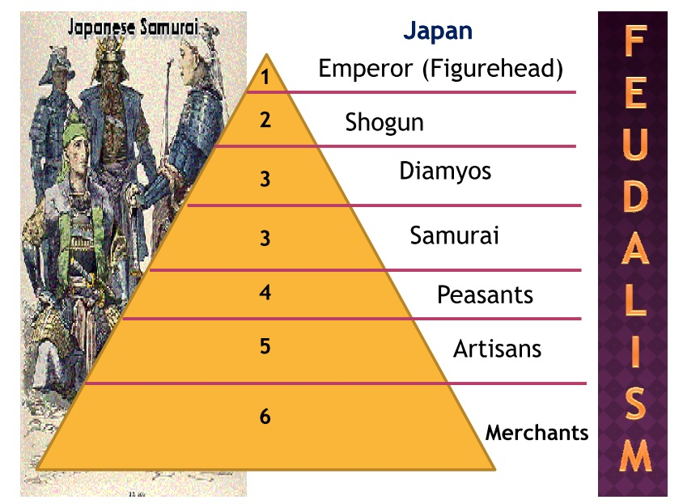
Japan
- archipelago (chain of islands)
- limited natural resources, relied on sea for food
- early Japan was organized into clans, or family groups
Japanese Feudalism
- Bushido- Samurai code of loyalty (similar to chivalry)

Slide 27
Renaissance
“ Rebirth in Greek and Roman Culture”
- period of time of great creativity and change in Europe
- Began in Italy in the mid 1300s and spread northward into Europe
- Due to vast amount of wealth generated from trade
Concept of Humanism = focus on individualism
- Invention of the Printing Press (Johann Gutenberg)
- books became more available, literacy increased, ideas spread rapidly

Slide 28
Protestant Reformation
Europeans broke away from the Roman Catholic Church and formed new Christian Churches (ended religious unity in Europe)
Causes of the Protestant Reformation
- Renaissance led people to question the Roman Catholic Church’s authority
- Objections to church abuses such as selling indulgences
Protestant Reformers
- Martin Luther (95 Theses)- Lutheran Church
- John Calvin (Calvinists)
- Creation of the Anglican Church ( Church of England)

Slide 29
Rise of Absolute Monarchies
- During the late Middle Ages, feudalism and the power of the Roman Catholic Church declined
- Monarchs began to increase their power and consolidate feudal lands
- Leaders used the divine right theory to justify their power (think Mandate of Heaven)
- Examples: Louis XIV in France, Ivan the Terrible in Russia, Charles I in England
Limits on Absolute Power
-Magna Carta - Limited the power of the English king
- English Bill of Rights - further limited the power of the English monarchy (limited monarchy)
-Glorious Revolution - Protestant takeover of England from the Catholics

Slide 30
Age of Exploration
Mesoamerican Civilizations
- Cultures of Central and South America
1) Mayas - established large cities in southern Mexico and Central America
2) Aztecs - later civilization that covered most of Mexico, militaristic culture that took over many other cultures
3) Incas - established large cities in the Andes Mountains in South America

Slide 31
Age of Exploration
Triangular Trade
- trade that involved Europe, Africa and the Americas
- slaves were brought from West Africa to solve labor shortage in the
Americas, raw materials brought to Europe from Americas, finished
goods went from Europe to the Americas and Africa
Columbian Exchange
- an exchange of people, plants, animals, ideas and technology throughout the Americas and Europeans
Inventions
- Astrolabe - Magnetic Compass
- Larger Sails - Better Maps

Slide 32
Warm Up (1/6/16)
On your index card, answer the following questions:
When is your final exam for this class?
What time do you need to be here?
What do you need to bring?
What is your goal for the final? Be specific.
What can you do this week and next week to ensure that you reach your goal?
When is the last day to turn in work for this class?
**If you have your project today, you can put it in the box for 20 points off**

Slide 33
NC Final Exam Review
Unit 5 & 6

Slide 34
Scientific Revolution / Enlightenment
Scientific Revolution
- Influenced by Renaissance, time period when thinkers began to question old ideas about the natural world and not simply rely on the Roman Catholic Church
Scientific Method
- New approach to science that relied on experimentation and observation
Individuals of the Scientific Revolution
- Nicolaus Copernicus - Rene Descartes
- Galileo Galilei
- Isaac Newton

Slide 35
Scientific Revolution / Enlightenment
Enlightenment
- period in the 1700s in which people rejected traditional ideas about government and supported a belief in human reason
- new way of viewing authority, power, government and law
Leading Thinkers of the Enlightenment
- John Locke - John-Jacques Rousseau
- Baron de Montesquieu - Voltaire
Impact
- Questioned the power of European monarchs and role of the citizens in government

Slide 36
French Revolution and Napoleon
Causes
France was under control of an absolute monarchy that denied citizens a say in government
Social Inequality - The Third Estate resented its heavy tax burden
lack of rights and lack of voice in government
Enlightenment thinkers called for democratic reforms
Effects
Rise of Napoleon Bonaparte
Revolutionary ideals spread throughout Europe
Ideals of Democracy and Nationalism swept throughout Europe

Slide 37
French Revolution and Napoleon
Napoleon Bonaparte
Became leader of France after the Revolution
Established a vast empire throughout
Napoleonic Code- legal code that included many Enlightenment ideals
Brought about many democratic reforms to France, but eventually declared himself Emperor (looked a lot like another absolute monarch)

Slide 38
Latin American Revolutions
Revolutionary and Enlightenment Ideals spread from Europe and the United States to Latin America
These ideals inspired independence movements in Latin America
Important Individuals
Toussaint L’ Overture - Haiti
Simon Bolivar - Venezuela, Columbia, Ecuador, Peru and Bolivia
Jose de San Martin - Argentina and Chile

Slide 39
Industrial Revolution
Agrarian Revolution
- change in methods of farming including new tools, the enclosure method and crop rotation
- Led to rapid population growth and longer life expectancy due to improved diet
Industrial Revolution
- change in the production of manufactured good from the domestic system to complex machinery in factories
- use of the steam engine to begin the mass production of goods

Slide 40
Industrial Revolution
Causes
Industrialization began in Great Britain due to:
- plenty of natural resources of iron ore and coal
- many natural harbors and rivers for trade and transportation
- more available workers
- capital to invest in factories and businesses
Effects
- Urbanization (population shift from rural to urban areas)
- New class structure (growing middle class)
- New economic theories (Laissez faire)
- Improved transportation
- Terrible working conditions (long hours, little pay, dangerous conditions)
- Overcrowding of cities (spread of disease)

Slide 41
Industrial Revolution
Reforms
- New legislation to change working conditions
- Child Labor Laws
- Rise of Labor Unions to protect workers
- New Theories:
- Social Darwinism: survival of the fittest businesses
- Marxist Socialism: struggle between the rich and poor
Proletariat (Workers) vs. Capitalists (Owners)

Slide 42
Nationalism in Italy and Germany
Italy
- In late1800s, nationalist ideals spread throughout Europe. Wanted to end control of Austrian and Spanish control of Northern Italy. Sardinia led the Italian unification movement
Germany
- Nationalist movement spread throughout Germanic kingdoms. Prussia was the leading force behind Germanic unification (Otto von Bismark)

Slide 43
Imperialism
Japan
200 years of isolationism under the Tokugawa emperors
In 1854, United States opened up trade with Japan
Meiji Restoration
- Used Western methods to develop an industrial economy in Japan
- Increased military strength
Effects
- Became an industrial and military power in Asia
- Began a policy of imperialism in Asia
- Increase in global trade

Slide 44
Imperialism
India
The British East India Company established a monopoly of trade in India
Exported natural resources (tea) to Great Britain and other countries
Eventually, British government took direct control of India
Africa
Berlin Conference: European powers divide Africa for colonization
Africa is exploited for its natural resources (gold, rubber, diamonds, human capital)

Slide 45
NC Final Review
Unit 7 & 8

Slide 46
World War I
Causes of the War
M = Militarism
A = Alliances
I = Imperialism
N = Nationalism
Assassination of Archduke Francis Ferdinand led to a chain reaction of the countries of the two alliances declaring war on each other
Triple Alliance (Germany, Austria-Hungary, Italy)
Triple Entente (Great Britain, France, Russia)

Slide 47
World War I
New Technology
- Trench Warfare - Tanks
- Machine Gun - Submarines
- Airplanes - Poison Gas
How does this change war?

Slide 48
World War I
Major Turning Points
- United States Entry into the War
- Russian Withdrawal (Russian Revolution)
End of the War
Treaty of Versailles
- Territory taken from Germany
- Military restrictions placed on Germany
- Germany accepted full responsibility for war
- Germany had to pay war reparations
League of Nations formed (to keep international peace)

Slide 49
Russian (Bolshevik Revolution)
CAUSES EFFECTS
-continued involvement in WWI - set up Communist government
-government infectiveness to solve problems - Creation of Soviet Union
-economic problems in Russia
IMPORTANT INDIVIDUALS
-Vladimir Lenin -Joseph Stalin

Slide 50
Rise of Totalitarian States
Germany
After WWI and harshness of Treaty of Versailles, Germany entered a period of economic and social chaos
Adolf Hitler rose to political prominence after he promised to provide jobs and rebuild Germany
Became dictator and turned Germany into a totalitarian state(Third Reich)
Italy
After WWI, Italy suffered through economic chaos
Benito Mussolini took advantage of the social unrest
pledged to solve Italy’s problems and strengthen the country
established a fascist state in Italy

Slide 51
Rise of Totalitarian States
Japan
Suffered through economic and social problems after WWI
Militarists and extreme nationalists gained control
Believed the only way to solve country’s problem was to establish colonies in Asia
Began Imperialist takeover of various regions of Asia

Slide 52
World War II
Causes
Italy, Germany and Japan aggressively sought to expand their empires
Western Democracies adopted a policy of appeasement
Treaty of Versailles!
Germany invades Poland
Alliances
Allied Powers - France, Britain, Soviet Union, United States
Axis Powers - Germany, Italy, Japan
US Involvement after Pearl Harbor
Holocaust: Genocide that killed 6 million Jews

Slide 53
World War II
End of the War
Hiroshima and Nagasaki (atomic bomb dropped on Japan)
After the war…
Nuremberg Trials: Germans punished for war crimes
Formation of the United Nations (replaced League of Nations; sought to keep international peace)

Slide 54
The Cold War
Two main superpowers emerged from WWII
United States (Capitalist)
Soviet Union (Communist)
Containment: stop the spread of Communism
Marshall Plan: massive economic aid package designed to strengthen democratic governments and lessen the appeal of Communism after WWII
NATO: alliance of Western democracies
Warsaw Pact: alliance of the Soviet Union and its satellite nations
Iron Curtain: symbolized the division of Europe between Communism and Democracy

Slide 55
Conflict During the Cold War
Division of Germany
The Berlin Wall was built to divide the City of Berlin into Communist East Berlin and Democratic West Berlin
Korean War
North Korean Communists invaded South Korea
US and UN forces prevented a Communist takeover
Vietnam War
North Vietnamese Communists invaded South Vietnam
After US left, North Vietnam took over South Vietnam

Slide 56
Conflict During the Cold War
Cuban Missile Crisis
Soviet Union began to strategically build nuclear missile sites in Cuba. After a US blockade of Cuba, the Soviet Union agreed to remove the sites
Nuclear Arms Race
US and Soviet Union developed and stockpiled nuclear weapons in preparation for war

Slide 57
Collapse of Communism
Causes
Introduction of new ideas (Glasnost, Perestroika)
Economic problems
Freedom movements in Eastern Europe
Effects
Formation of the Commonwealth of Independent States
End of the Cold War
Transformation of Eastern Europe
**The Fall of the Berlin Wall symbolizes the end of the Cold War**

Slide 58
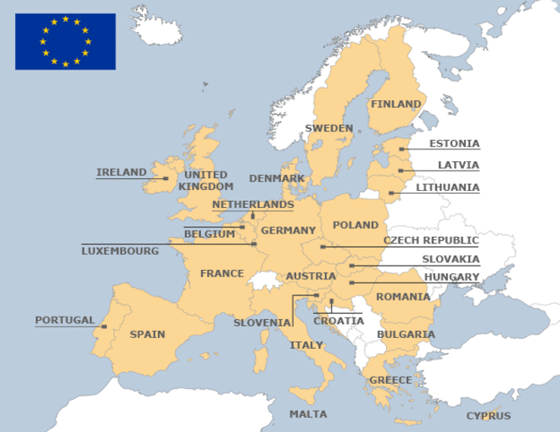
Global Economy
Developed vs. Developing countries
NAFTA (North American Free Trade Agreement): Trade agreement between North American countries to trade without taxing each other
EU (European Union)
OPEC (Organization of Petroleum Exporting Countries): Controls Oil Supply

Slide 59
Modern Issues
International Troubles
Israel and Palestine
Iran (Nuclear Weapons)
Afghanistan
North Korea (Nuclear Weapons)
Terrorism (ISIS, Al Qaeda, IRA)
Environmental Concerns
Global Warming (Greenhouse Effect)
Overpopulation
Deforestation and Desertification
Human Rights
Rwanda, Ukraine, Cambodia
Women’s Rights
Civil Rights
Poverty (Globalization?)
Technology
Internet Revolution
Social Media
Medical, military technology
Cyberterrorism

